Slide 1
RGP Semester 2 Task
Shu Lo
Ziling Xu
Eric Ndumbu
Andrei Niculescu-Duvaz

Slide 2
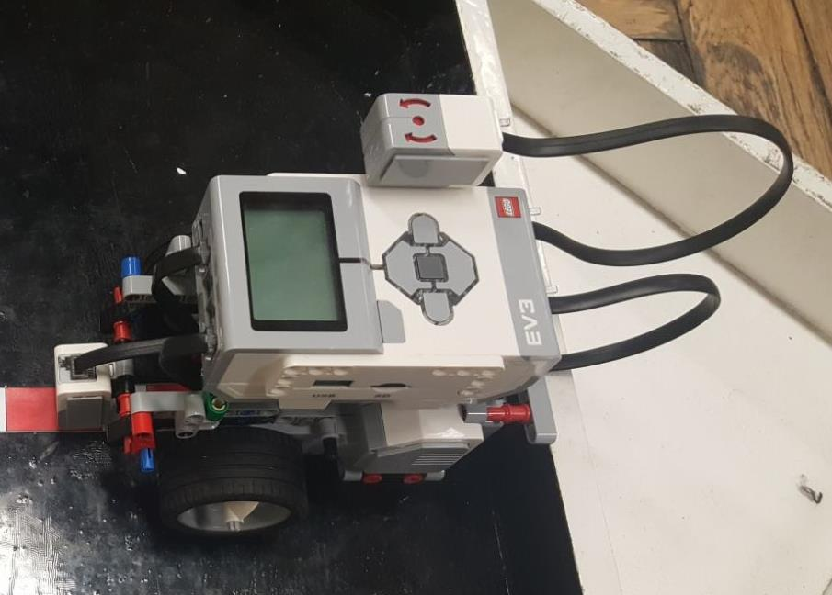
Hardware Design
Robot Dimensions:
Notes:
Hardware Design
Dimensions: 12 cm by 19 cm
Sensors attached – GyroSensor and Color Sensor
We designed the robot to be as compact as possible to navigate small spaces
At the same time we wanted our robot to do tight turns so we didn’t raise the block

Slide 3
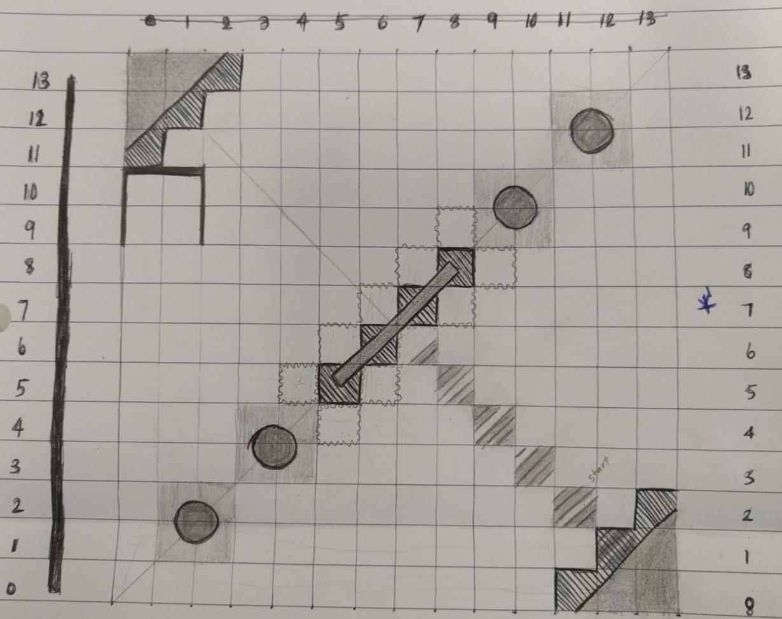
13 12 11 10 9 8 7 6 5 4 3 2 1 0
Notes:
Localization Slide

Slide 4
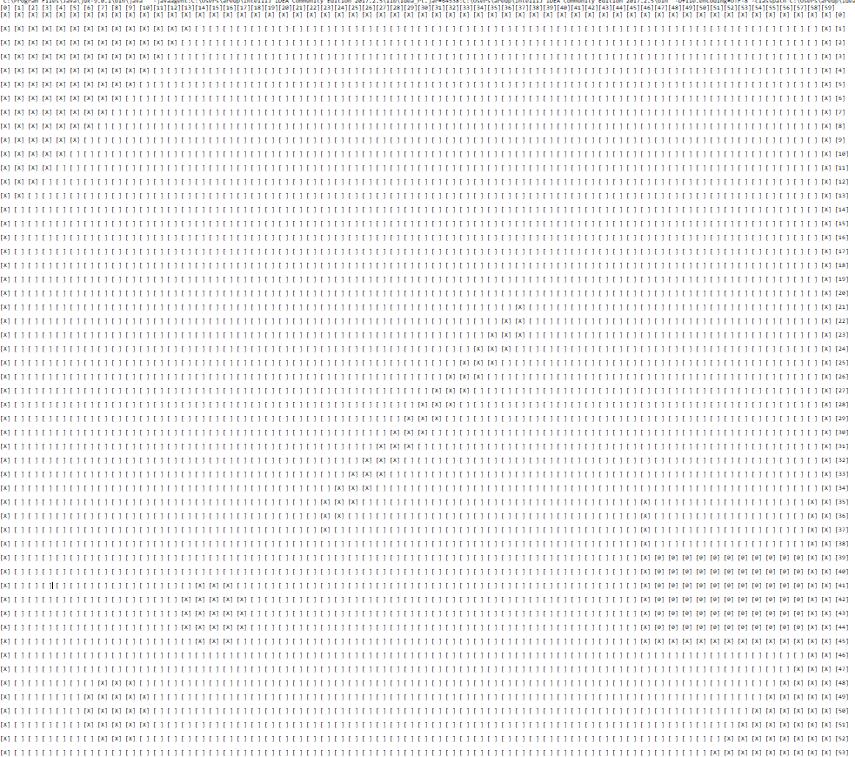
Notes:
Map
How we decided the dimensions of the map vs real dimensions of the arena
Explain code implementation of the map (which objects are hard coded in)
Explain how the map implements the obstacles that are given on the day of the exam
Explain how the map interacts with the rest of the code

Slide 5
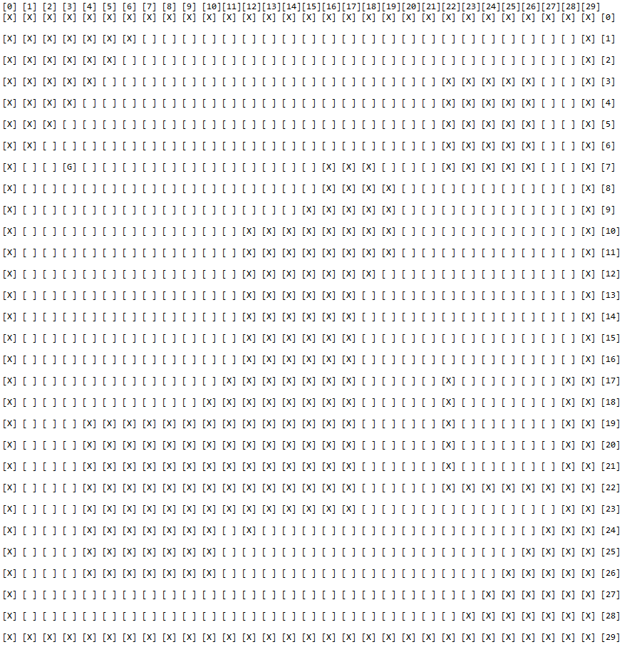

Slide 6
Localisation
Localised using bayes filter with a colour input.
Has 2 functions for calculating position.
filter(colour):
which takes the argument for the colour value read by sensor and calculates probability with motion and colour sensed and stores in a array of probabilities for the positions. Doesn’t run motion calculation at first occurrence.
mapLocation():
Checks over all the probabilities in the probability array looking if there only one point with the max value of the probabilities and checks if its greater than 0.15.

Slide 7
Testing Localisation
First iteration with colour value input less than threshold (no movement calculation):
Cell: null
Did not find location.
Second iteration with colour value input less than threshold:
Cell: null
Did not find location.
Third iteration with colour value input greater than threshold:
Cell: null
Did not find location.
Fourth iteration with colour value input greater than threshold:
Cell: null
Did not find location.
Fifth iteration with colour value input less than threshold:
Cell: project.AstarCell[x=6,y=6]
Robot in the cell [6,6].

Slide 8
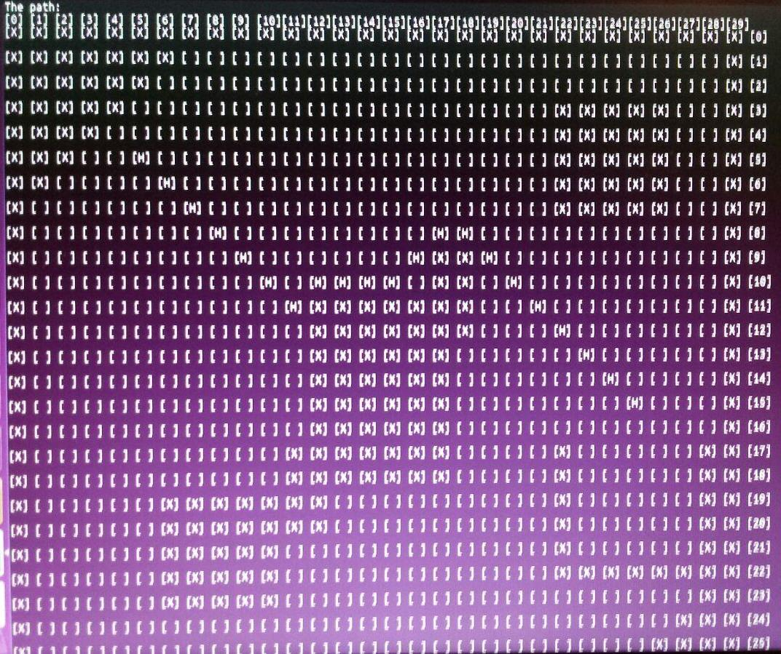
Notes:
Box Map implementation and background of Astar
Explain how the Box Map relates to the Map and why we need the conversion to Box Map
Explain what a cell is and its function
Explain why the objects have been thickened in the box map as opposed to the map
Explain that the box map was also used in debugging the Astar algorithm as it provided a visual insight on the path the robot takes

Slide 9
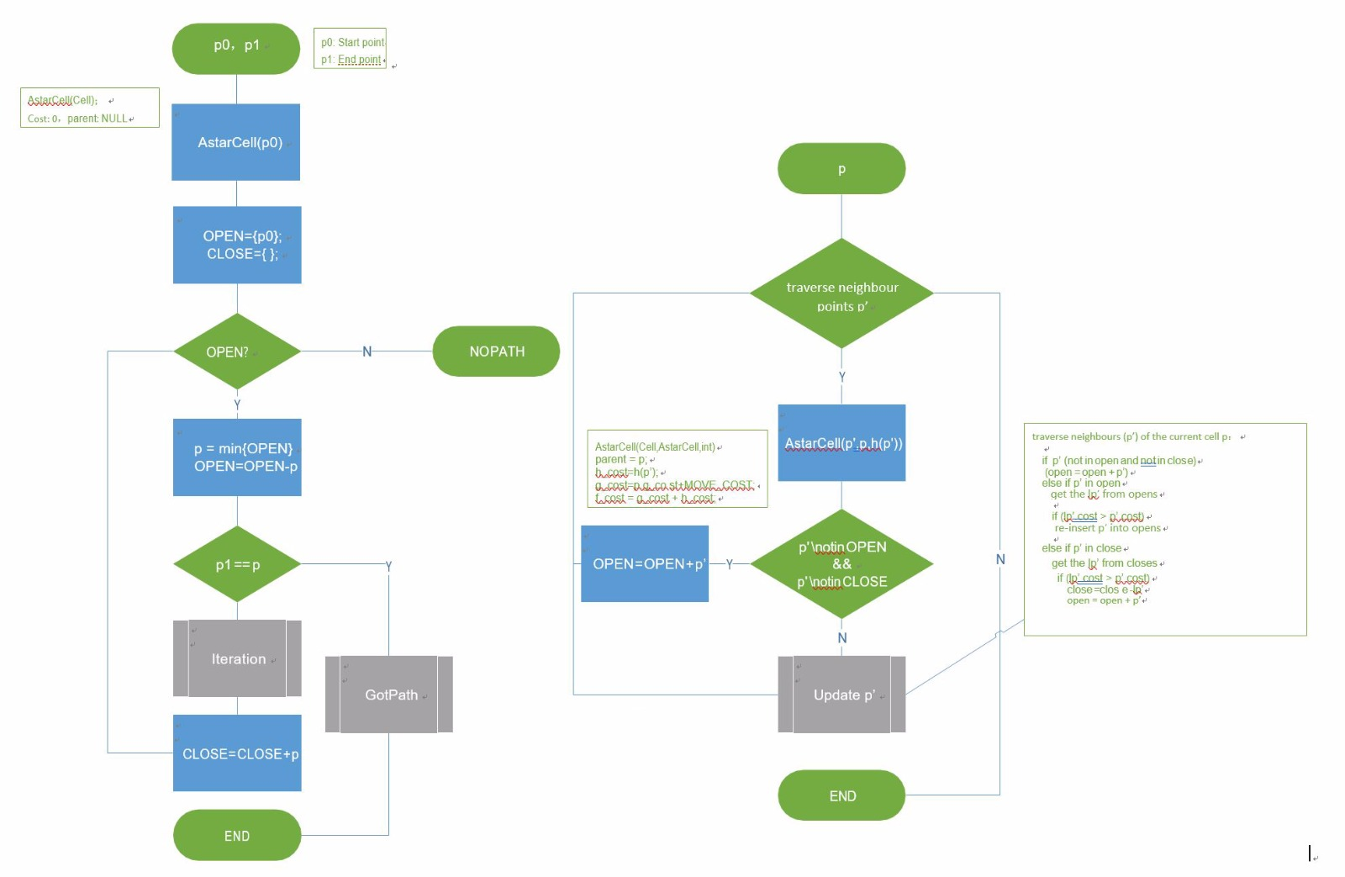
Notes:
Astar Algorithm
Explain the Astar Algorithm (how the Algorithm deals with obstacles, how distance is treated)
Explain how the Astar algorithm interacts with the boxmap

Slide 10
Team Management
Hardware Design – Shu & Ashley
Initial Gyrosensor testing - All members
Map design – Andrei
Localization – Eric
Astar Algorithm and BoxMap Implementation – Shu & Ashley
Differential Drive – Andrei & Eric

Slide 11
Additional Improvements
Improve Astar algorithm to avoid thickening of obstacles on BoxMap
Wire placement
Localisation could also store the previous colour read and compare it to the current and only update the map values that adhere to these 2 values when moving.

